Slide 1
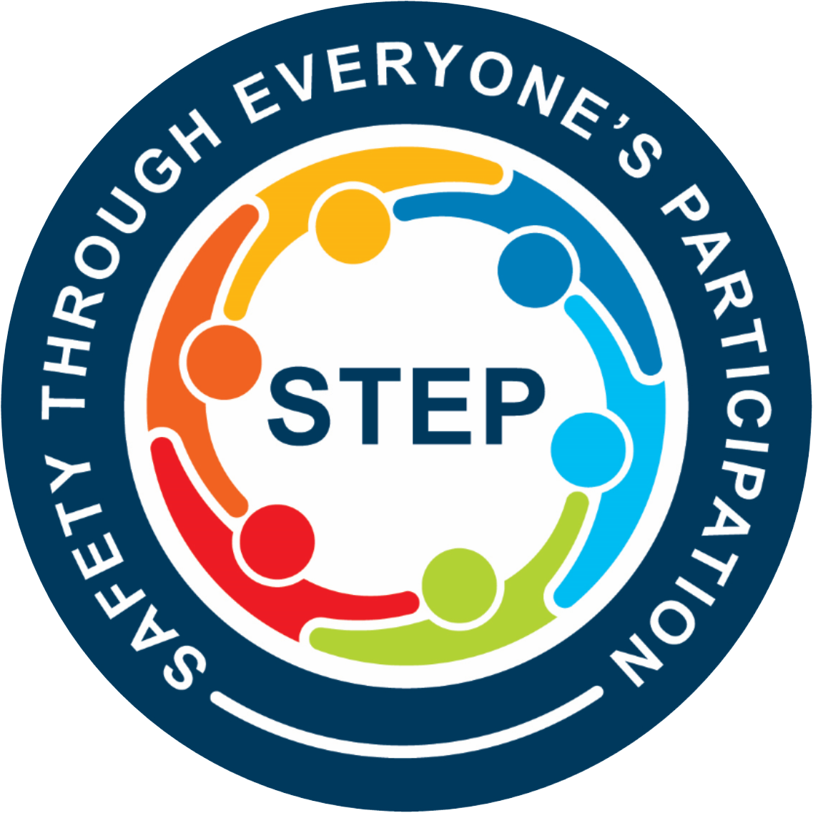

Observer Training
Instructor: Ulysses Fogle
Notes:
Welcome!
Do introductions- I would like you all to introduce yourself, tell us how long you’ve been working, and your favorite: (pie/vacation/meal/hobby/vacation…use something personal – not sports).
One break in the middle
Safety moment…
We are very serious about this STEP Process from XXXXXX on down. We all will be held accountable for the information from these sessions.
Tell a story about a safety incident that affected you. What did you do? What challenges were there and how did you deal with it?

Slide 2

Quality
Production
Safety
Notes:
Sometimes our work seems to be fragmented…we focus on schedule…until there is rework, then it’s quality…which then puts us behind schedule and we drive work….then safety is at-risk. Is that how it should be? What do you leaders/companies focus on? How important are these metrics to you organizations…what gets the most attention? When does that attention shift? If some gets seriously hurt or dies, all the other silos are irrelevant. We need to break down our silos are look at our projects more as interrelated systems. We need a STEP change in thinking…we have been doing well, but people are still getting hurt….we are not finished yet.

Slide 3
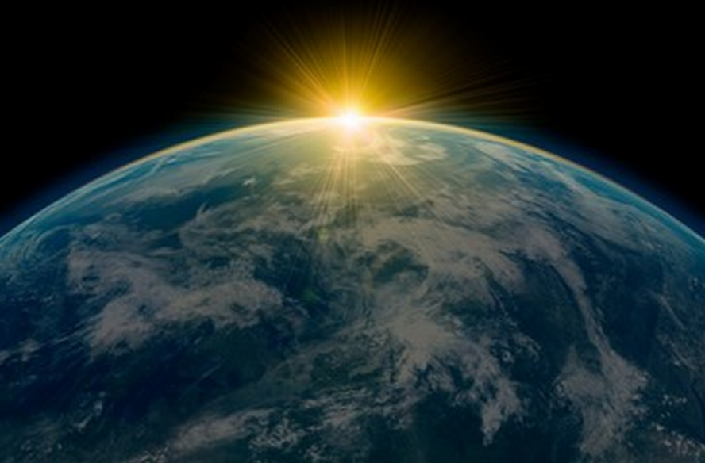
Notes:
We make a living by what we get, but we make a life by what we give.
Far and away the best prize that life has to offer is the chance to work hard at work worth doing.

Slide 4

Agenda:
STEP Purpose
Engagement
STEP Process
Participation
Data Use
Quality
Notes:
REVIEW SLIDE:

Slide 5
STEP Purpose
We will achieve… Safety Through Everyone's Participation.
We will do this through actively engaging all employees to look out for the health and safety of each other.
We will identify and prevent situations that could result in serious injury or the loss of a life.
This information will be communicated on a regular bases with solutions and fixes.
We will strive to have better safety conversations
Notes:
REVIEW SLIDE

Slide 6
STEP Vision
To create a dependable, repeatable method to measure safety successes using leading indicators instead of just Recordable Rate and Lost-Time Injuries.

Slide 7
Goal: #1
Get Us to
Think Differently
About Safety
Notes:
- Some of the points that you will see in this training are redundant. This in intentional.
- These conversations are uncomfortable. It is hard to go up to someone that is potentially doing something at risk. Its hard for them to be approached. Understand this and be mindful of it. But we are doing this because we care!

Slide 8
How do we Think about Safety?
We need to shift our thinking:
Safety is:
#1 Priority or Core Value?
Can Change Instantly
Changes Over Time

Slide 9
Goal: #2
Understand How We
Currently Think
About Safety

Slide 10
How is
Safety Motivated?
Internal or External?
(Responsibility)
(Accountability)
Notes:
BOTH…

Slide 11
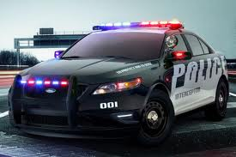

Accountability:
After the fact
Lagging
Consequences
Only when someone is watching!
Notes:
Think of it this way…I am responsible for my driving behavior. A policeman has the authority to uphold the LAW. However, both of us are ACCOUNTABLE for our duties, me obeying the speed limit and the officers for upholding it.

Slide 12
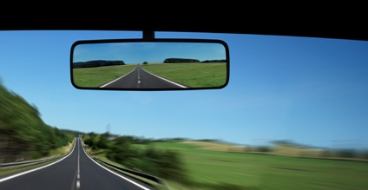
Definitions
Lagging Indicators
Measuring an organization’s safety performance based on historical loss information
Examples:
OSHA Recordable Incidence Rates
Lost Workday Case Rates
First Aid cases
Near Misses
Notes:
We are trying to move away from the lagging indicators. We never see the lagging coming, they are oh so clear in the rear view mirror.
We only have all the answers because we can see the outcome.
Try not to jump to conclusions. Try to put yourself if the situation to understand.

Slide 13
Responsibility:
Before
Leading
Ownership
What you do… when no one is watching!

Slide 14

Definitions
Leading Indicators
Measurable factors of performance that may indicate a particular direction or trend
Examples:
Job Hazard Analyses / Job Safety Analyses
Observations
Employee Perception/Safety Culture Survey
Training Completion and Effectiveness
Notes:
We need full focus and engagement in these processes.

Slide 15
We Want People to
Work Safely
Even When
No One is Watching!
Notes:
I am not speeding because I see the highway patrol over there. Vs. I am not speeding because I know it’s the right thing to do. Because I know those signs are posted for my safety.

Slide 16
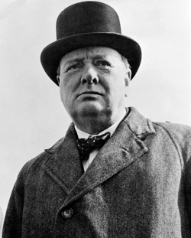
Character is what we do
when no one is watching
– Churchill

Slide 17

Where do we start?
Make it Personal
Safety
Step-Change
Trust
Active Caring
Notes:
Understand we are intruding on someone's space/ work area. Try to make things personal, but be mindful of your approach. Talk and approach people how you want to be approached.

Slide 18
How do we Create a
Step-Change in our
Safety Culture?
…through
Making Safety Personal

Slide 19
Our Most Valuable Resource is our Human Resource.
Notes:
What could we get accomplished with out the Human Resource. Even fully automated systems need human beings for maintenance and repair.

Slide 20

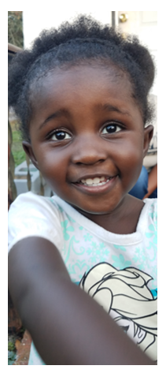

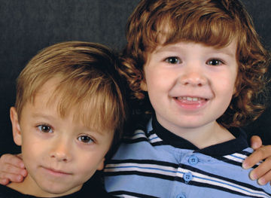
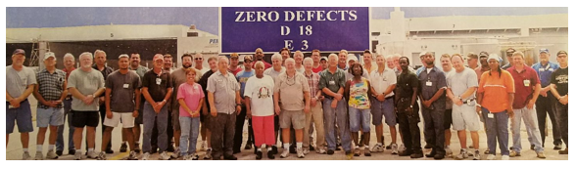
Why Should I work Safely?
Who Would Care
If I Was Injured?
Notes:
What is the worst thing that can happen if I take this risk? Who will I not see again if I take this risk?
No one goes into work thinking they are going to get hurt today.

Slide 21
Active Caring
Make it Personal
Safety
Step-Change
Active Caring

Slide 22
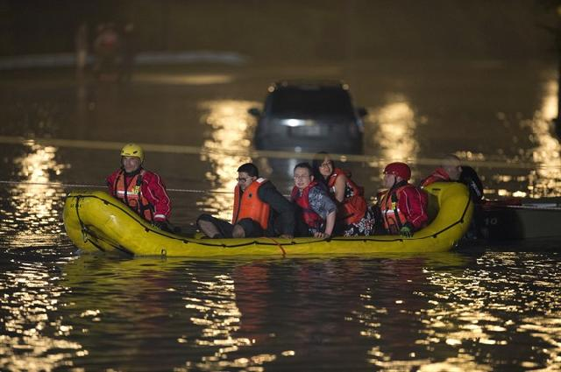
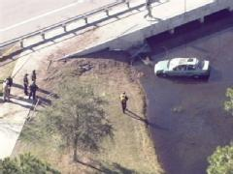
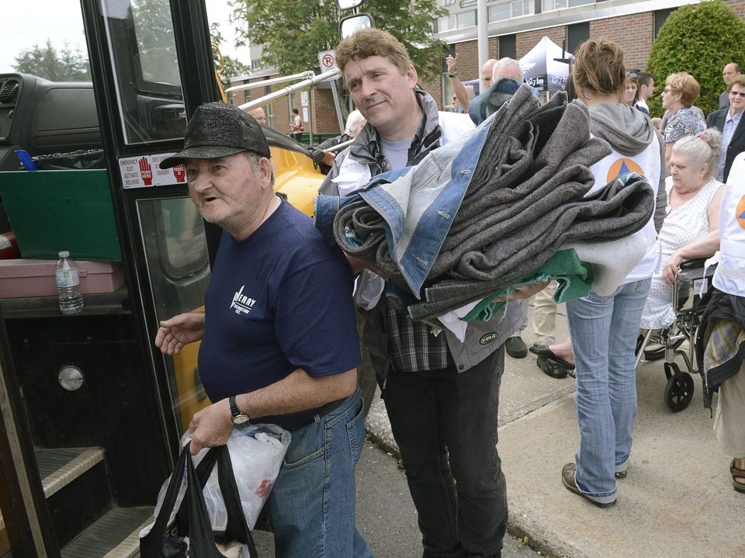
Active Caring
Moving beyond simply caring to acting on that caring

Slide 23
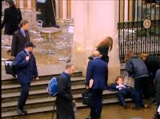
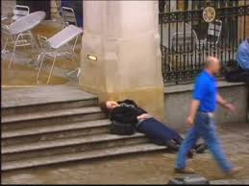
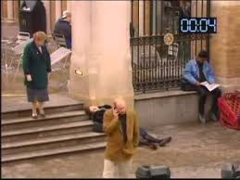
AC to Overcoming Bystander Apathy
Bystander Apathy = Not acting on that sense of caring
If everyone “cares” then how can we have this?
Kitty Genovese was killed outside her apartment
38 neighbors saw her get attacked…no one called….Why?
Diffusion of Responsibility…some on else will call/take care of it…

Slide 24
Completing the Triangle
Make it Personal
Safety
Step-Change
Trust
Active Caring

Slide 25
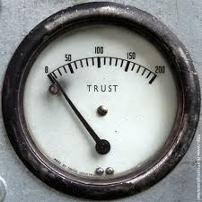
How Do You Lose Trust?
How Is Trust Important to Safety?

Slide 26
What’s Important for Safety Culture?
Trust
Firm reliance on the integrity, ability, or character of a person or thing.
Trust in Management:
Intentions
Behaviors
Trust in Coworker:
Intentions
Behaviors

Slide 27
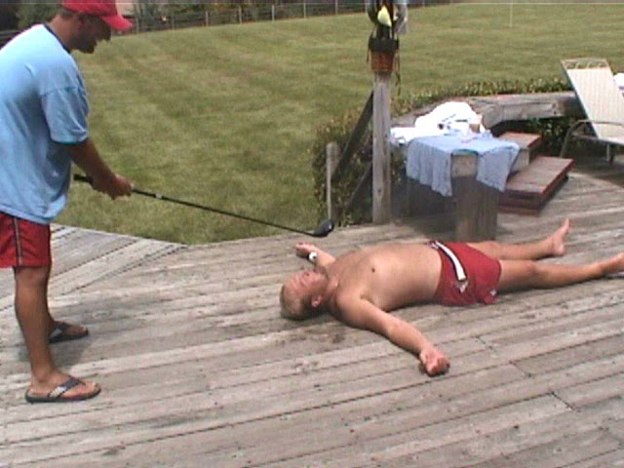
Notes:
High level of jubilance at the end. Flip that response had something gone wrong. Hit him in the temple/ jaw…

Slide 28
Agenda:
STEP Purpose
Engagement
STEP Process
Participation
Data Use
Quality
Notes:
REVIEW SLIDE:

Slide 29
Creating Employee Engagement
Involvement vs. Engagement
!!!
Notes:
Many are involved but to get people engaged must create a value proposition. The Chicken is just involved with breakfast but the pig is totally engaged.

Slide 30
The ABC Model of Behavior
Activator
Behavior
Consequence
Provides Motivation
Gives Direction
Notes:
Candy example.
This next model will help you become a better leader in general…this model helps understand why people do the things they do. In general, becoming a good manager is being able to understand why people do and don’t do the requested behaviors.
BEHAVIOR:
A behavior can be defined as anything you can see another person doing…going back to the Safety Triad (Person, Behavior, and Environment), one way to distinguish Behaviors from Person Factors are to ask yourself if they are observable. Ask the Participants this question: “Can you see a person’s attitude?” …some will say “yes”, but challenge them further by asking: “How do you know they have an attitude?” By their behaviors! We can’t look into someone’s head and see their attitude, but we can look at their behaviors and interpret they may have this attitude or that attitude. So it make it more objective to focus on Behaviors.
ACTIVATORS:
Activators (or technically called Antecedents) come before what we do and give us direction. They do not force us to do behaviors, they simply inform us that if we are going to do a particular Behavior, now’s a good time to do that behavior. There are Activators all around us: clock, deadlines, stop signs, rules/regulations, policy/procedures, even commercials try to get us to “act” and go out and buy their products.
Even though Activators are all around us trying to guide our behavior, we don’t always follow Activators. Ask the questions to the class: “How many of you speed?” Then follow up with “Did you not see the speed limit signs? …then why did you speed?” Next ask the class: “How many of you come to a complete stop at a stop sign” (jokingly, remind them that a complete stop means the vehicle come to a complete stop!). Then follow up with the questions “How many of you would come to a complete stop with officer ‘friendly’ on the other side of the intersection?” the stop sign is still trying to Activate the same stopping Behavior…so what is the difference? The potential Consequences!
CONSEQUESNCES:
Consequences follow our Behavior and are the things that truly motivate what we do every day. So anything you have ever done, or ever will do, has been or will be motivated by avoiding negative consequences or achieving positive consequences.
Now to clarify, Activators don’t motivate behavior…they occur before we do any behaviors and simply direct us. When you were young and your mother told you “Don’t touch that stove it’s HOT!” what did you do…touch it!” Your mother’s Activator didn’t motivate you, but the Consequences you received from touching the stove surely motivated your future behavior! So, when your mother gave you that Activator in the future, “Don’t touch that it’s hot,” we learn from Consequences and we follow our mother’s Activator.
Model illustrates what people do, what directs the behaviors, and consequences of the behaviors
Activator
Those things that encourage one to behave in a certain way; i.e. “Now is a good time to do this behavior.”
Activators are not motivators
Examples: alarm clock, stop sign, empty stomach
Consequences
Provide motivation; i.e. don’t get up when the alarm clock rings on a day off

Slide 31
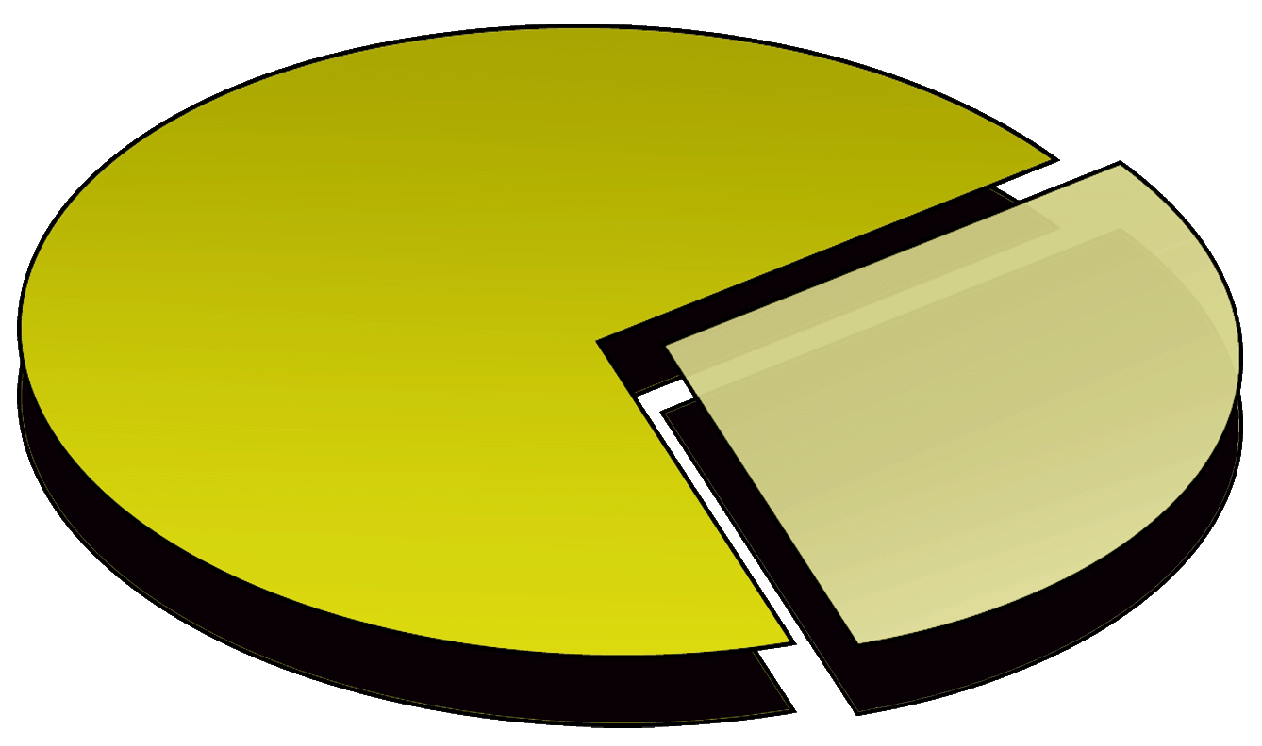
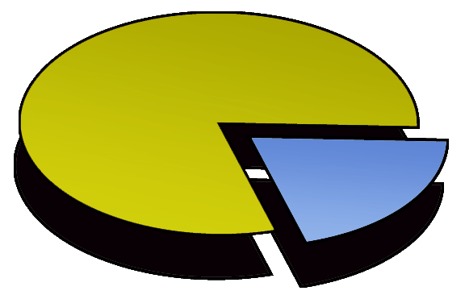
So, We Need to Understand Human Error
…of those Human Errors:
When ever we have Incidents:
70%
Weaknesses in
Safety Systems
80%
Human Errors
30%
Individual Errors
20%
Equipment Failures
Notes:
Review the pie chart.
The main point here is that in the majority of the cases they are other “system” related factors that are producing the risky behavior or human error.

Slide 32
Characteristics of Effective Consequences
Powerful
Consequences
Certain
Soon
Significant
Weak
Consequences
Uncertain
Delayed
Insignificant
Notes:
Hand in the cookie jar example.
Let’s focus on Consequences for a moment. What makes one consequence more powerful than other consequences? The most powerful ones are Certain, Soon, and Significant.
If I drive through a Stop sign with an officer sitting on the other side of the intersection, I am fairly Certain he would give me a ticket. When I put a cookie in my mouth, I know I can count on that good taste immediately. And if I touch the stove after my mom gave me an Activator not to…I am sure I would have gotten a Significant Consequence! All those are very powerful at motivating future Behavior.
Now let’s talk about the consequences that have weak motivational power. Those consequences that are uncertain to happen, or if I do get a consequence it’s delayed, or even if the consequence happens, it’s no big deal…these have little impact on future behavior.
If I speed 5 miles above the speed limit on the highway, it is Uncertain that I would get a ticket. When I eat that cookie the extra pounds that I could put on are delayed (they don’t happen immediately!). And, finally the extra weight I may put on from one little cookie is most likely Insignificant.

Slide 33
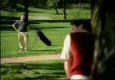
Certain, Soon and Significant?
Notes:
To one person it was insignificant; to another it was soon and significant.

Slide 34
Why are Safe Behaviors Hard to Motivate?
Consequences of Safe behaviors:
Less Comfort
Less Convenience
More Time Consuming
Consequences of At-Risk behaviors:
More Comfort
More Convenience
Less Time Consuming
Notes:
Easier to just do what you need to do – I’m just going to get in and get it done. Ex: Not wearing fall protection.
Everyone realizes the potential severe consequences of risky behavior. So everyone is doing 100% safe behaviors? They why are safe behaviors so hard to motivate? Well to start with, we are internally wired to find the quickest, easiest and most comfortable way of doing things. So how does that relate to safety?
Let’s take a look at the consequences of Safe Behaviors. Most of the time safe behaviors are less comfortable, less convenient and take more time to do. For example, why doesn’t everyone always wear safety glasses? They don’t fit and hurt my ears, they fall off when I work, they are in my truck…besides, I am only doing a 1 minute job here.
Now let’s take a look at the consequences of At-Risk Behavior. Most of the time risky behavior is more comfortable, quicker, and takes less time. What are the consequences for people not wearing their Hard Hat? It’s more comfortable, it’s more convenient when doing this task because it keeps getting it the way or keeps falling off, or it would take me more time to go back to the truck than just do this quick job and then move on to the next trouble call.
To even make it more difficult to motivate, the consequences of risky behaviors are typically very powerful; Certain, Soon, and Significant.
Another aspect that makes safe behavior hard to motivate is that risky behavior seldom results in a negative consequence. It’s good that injuries are rare, but this may give us a false sense security. Have you ever heard the phrase “That’s how we’ve always done it!” So experience tells me that if I speed in my car, it is possible I can get a ticket…not probable, though. And even less probable that I am going to get into a car crash!
So, we “weigh” the riskiness of situation. Now ask the participants this question: “How many of you conceder yourself a safety leader?”…then ask them this: “OK then, how many of you have ever stood on a chair to change a light bulb!?”…now you can give them the following example: “Here is an example of how we might use the scales (pictured on the slide) ‘weigh’ the riskiness of a situation…It is a few minutes before the big game and you just notice that you need to change the light bulb in the ceiling before your friends come over.” Now the scales come out… “You have the new light bulb and you think to yourself, I could go out to the garage and get the ladder, or I could stand on this chair to reach it”. “It would take more time to go out to the garage to get the ladder and more inconvenient.” “Now It’s a whole lot quicker to stand on the chair and the chair is right here (more convenient)”. So, what do we do? We jump up on the chair! Again, look at the certain, Soon & Significant aspects of this example!
So, we might not “consciously” weigh those out in our mind…it may only take a fraction of a second…but that’s how many safety decisions are made and how consequences play a role in those decisions.

Slide 35
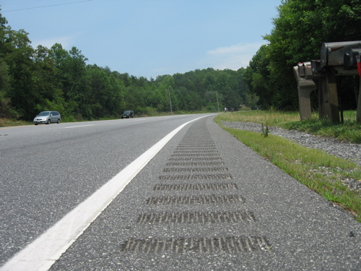
Activator or Consequence Strategy?
Notes:
Rumble strips… Which strategy? Activator or consequence? Well, as we drive, we don’t look at the road and think oh…bumps! I better not drive on the side of the road! …no, we mostly notice them when we need them….as we are driving off the road. They occur After the behavior…so they are a Consequence Strategy!
Activator – Lets you know before you go in the ditch.
Consequence – If you go is to stay between the lines.
It is in the perspective.

Slide 36
To Err is Human, But is that a Good Thing?
YES!
“Never remove a safety barrier
that has dents in it…”
Notes:
…this slide sums up Human Error….1) reducing error-likely situations and as this slide suggests, 2) reducing the potential consequences if an error does occur.
Apparently it’s doing its job.

Slide 37
Current Views on Human Error
Human error is a symptom of trouble deeper inside a system.
To explain failure, do not try to find where people went wrong…
Instead, analyze how people’s assessments and behaviors would have made sense at the time, given the circumstances that surround them.

Slide 38
What Motivates a Better Safety Culture?
Culture
Environment
Leadership
Behaviors
Core
Values
Notes:
It is virtually impossible to measure “culture”.
When people move form one organization to another, or when people visit different countries, people know there is a difference in culture, but it’s something that is difficult to put your finger on. So, how do we impact something that is not measurable? Well, how do we adapt to a new job or culture? When in a socially “ambiguous” situation, we first examine the environment. We try to match our past history with what we are currently seeing and merge the two together. In organizations, this “new” culture directly impacted by the leadership team; what they say, what they do, and how consistently they hold people accountable. So new employees may listen to what the leadership team says, but they will then observer their behaviors; they will see if management “walks-the-talk”. Most of the time, these observable behaviors are motivated by our internal core values. Very seldom do we ever go against our core values…they are our guiding principles and thus are strong motivators of our behaviors.
So to change a culture, organizations first need to revisit their Core Values and assess if the corresponding behaviors are being accomplished in a consistent manner. When leadership is seen as engaged in safety because they feel “it’s the right thing to do”, as opposed to “the thing I have to do”, then the Leadership of the organization can influence the environment and eventually the culture will follow.
Final questions: Which way do we influence Culture? (red arrows) From the Values out to the Culture, or from the Culture in to the values? Both, really…If we have weak core safety values, this may produce a weak culture over time. If the organization gets different leadership or goes through some external strife (e.g., merge, budget, economy), if our culture is so strong this will keep our core values in place.

Slide 39
After STEP: We are Hurting Less People
OSHA Recordable Rate for Construction Average = 3.8
Notes:
Following STEP, we hurt fewer people. We were gathering over 900% more information than before, having conversations with our contractors, and identifying areas for improvement.

Slide 40
But our Serious Injuries haven’t improved!
SIIR Defined: (Krause & Murray, 2014)
Life-Threatening Injury:
Significant loss of blood
Trauma to vital organs
Damage to brain or spinal column
Life-Altering Injury:
- Permanent or long-term impairment of loss of internal organ, body function, or body part
SIIR = Serious Injury/Fatality Incident Rate

Slide 41
Bottom Line: People are Still Getting Hurt
…we are not finished yet!
“WORLD CLASS”
“Best in Class”
Safety Improvement
Better
Good
Good
Great
We need a “STEP-Change” in our Safety Culture
Notes:
The STEP initiative is not a typical safety program that has a beginning and an ending (like safety bingo or an incentives). STEP was created by a team of operations, safety and leadership. To avoid the common safety “program” issue of “flavor of the month”, the STEP “process” was originally designed to evolve over time before the current version begins to become stagnate. So, we are not done yet…the next version of STEP has begun!

Slide 42
What is Behavior-Based Safety IS NOT
BBS does not focus solely on rules or regulations.
BBS does not assess policies or procedures.
BBS is not fault-finding, but fact-finding.
BBS does not replace audits or inspections.
BBS is not a “program” (although it can be if done wrong!).
Notes:
Again, these “type” of slides try to answer any criticism people might have or think of later…so we can address them in this workshop setting to control potential “worries” and “rumor-mill”

Slide 43
Agenda:
STEP Purpose
Engagement
STEP Process
Participation
Data Use
Quality
Notes:
REVIEW SLIDE:

Slide 44
STEP
Process Elements
Culture
Human Performance
Engagement
Leadership
Communication
Leading Indicators
Notes:
These are the STEP Process Elements…..It starts with the culture. It involves Human Performance, Engagement, Leadership from all levels, Communication and Leading Indicators.
Culture is what we do as an organization. Organizational culture impacts the organization in many ways. It is the unwritten rules. Some changes come quickly like a new CEO as where other changes evolve over time and is planned out. So to change culture we need to focus on other elements to help create the needed momentum.
Human Performance is why we do what we do.
Engagement is getting employees and craft to own safety. Engagement is necessary from all levels for success.
Leadership is inspiring people to be safety champions.
Communication poses the most issues. Its having the courage and consideration to communicate. How do we communicate information?
Lastly leading indicators are measurable factors that may indicate a direction or trend.

Slide 45
STEP – Process Overview
STEP is an observation and feedback process. It’s all about the conversation!
Work is observed…
…feedback is then given on safe and at risk behaviors, conditions & processes.
Data is collected using checklists or mobile devices.
The information is then analyzed, followed-up on, and communicated to everyone.
Notes:
More overview….Although this seems very data oriented, stress it’s about having more relevant conversations and trying to get ahead of incidents and injuries.
REVIEW SLIDE:

Slide 46
STEP – Process Overview
We are NOT trying to catch people doing something wrong…just have a conversation.
We are trying to understand why people are doing something at risk.
Additionally, we are looking for things in the system that are allowing or encourage craft to do at risk behaviors…and thus change/improve the system.
FACT Finding
Notes:
So our focus.
REVIEW SLIDE

Slide 47
Inspections, Audits, Observations
Inspections, Audits, & Observations
What are the differences?
Compliance-Based
Inspections: Used to assess compliance with rules & regulations.
Audits: Used to review the effectiveness of policies & procedures.
Observations: Used to give feedback on safe & risky behaviors.
Quality-Based
Behavior-Based
Notes:
Start out by asking how many people have done an observation. Then for the people how haven’t, ask why they haven’t. then ask the participants who have done an observation how they do them?
These are three different methods to help us identify leading indicators, holes in our barriers, and error-likely situations. They each represent unique ways of getting information about our culture and each offer opportunities to provide leading indicators to help make us proactive in our safety efforts.
Audits are quality based – are the people doing things according to procedure?
Observations – It is just as if not more important to comment on the Safe behaviors vs the at Risky behaviors. You are not a Fault Finder.
Make a sandwich as you have the conversation.

Slide 48
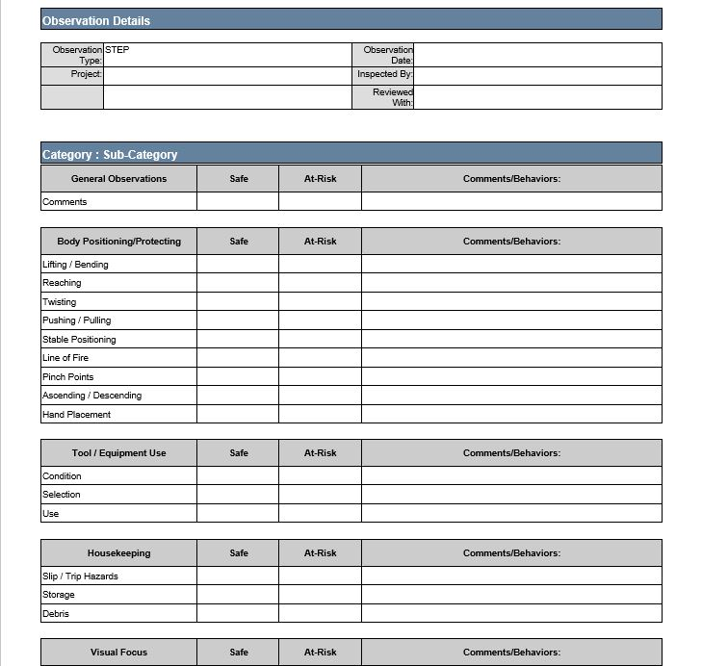
STEP Observation Checklist
Notes:
Review how to use the STEP checklist.

Slide 49
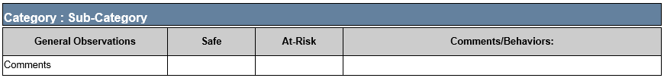
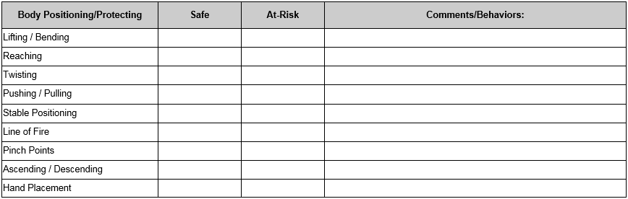
General Observations
The General Observations section is used to enter any behavior, condition, or process not covered by the STEP observation checklist.
Notes:
Review how to use the STEP checklist.

Slide 50
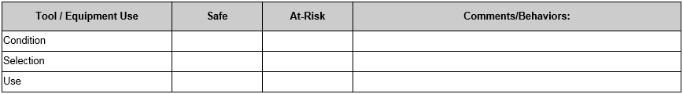
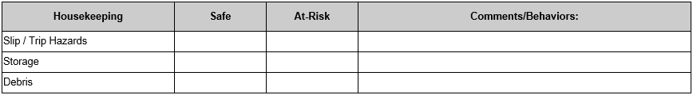
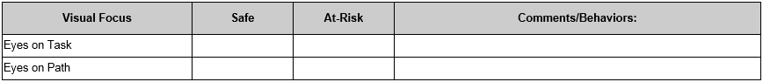
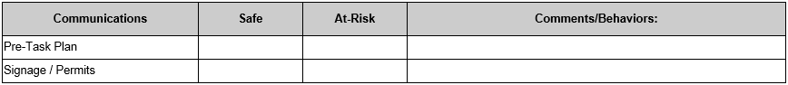
Observations Categories
Notes:
Review how to use the STEP checklist.

Slide 51
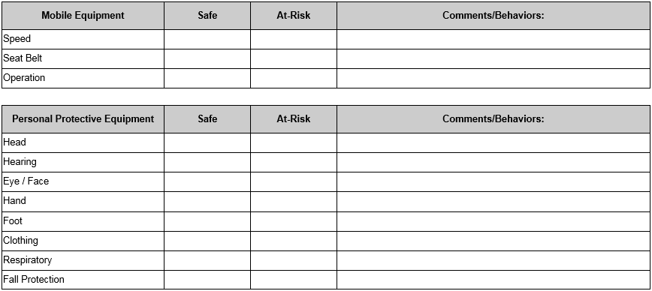
Observations Categories
Notes:
Review how to use the STEP checklist.

Slide 52
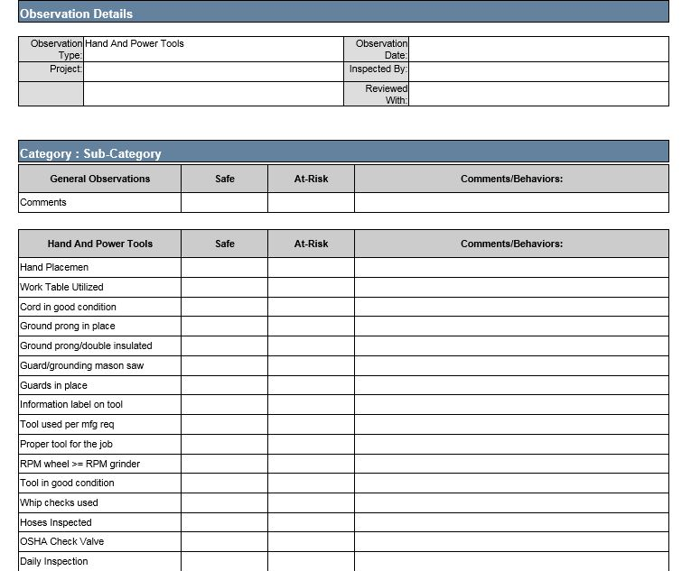
Focused Observation Checklist
Notes:
Review how to use the STEP checklist.

Slide 53
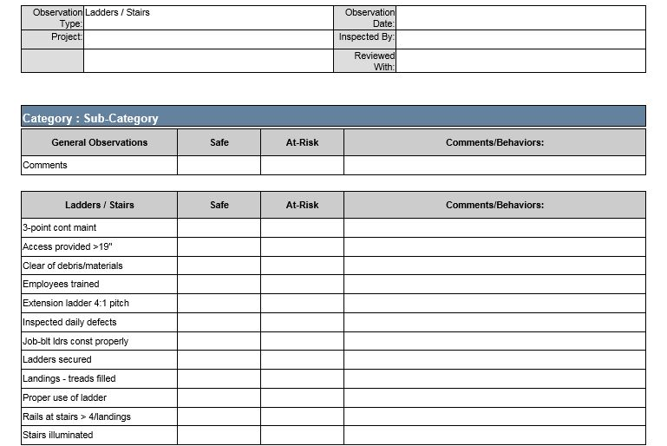
Focused Observation Checklist
Notes:
Review how to use the STEP checklist.

Slide 54
Define Severity - Exercise
Probability
Low
High
Low
Medium
High
Life Saved
Low
Severity
High
Notes:
Here is how we will define severity…with examples to follow.

Slide 55
Observation Exercise:
Watch the short video clip and use tally marks to
record as many Safe and At-Risk behaviors as you can see.
Safe:
At-Risk:

Slide 56

Let’s Observe…

Slide 57
Feedback Is The Key
People have an internal drive to feel competent.
Leaders’ behaviors (verbal & non-verbal) can impact craft future performance.
Feedback can be a consequence and a powerful motivator.
Both informal and formal recognition can motivate employees.
Help them feel competent by giving quality recognition.
Any recognition (negative & positive) you give send a strong message for future performance.
Quality recognition can help build a teamwork atmosphere.
Notes:
REVIEW SLIDE

Slide 58
We Need to Watch our Language
To change the way people think about safety, you have to talk differently about safety:
Achievement not failure oriented
Use At-Risk or Risky not Unsafe or Wrong: “I think you’re putting yourself at-risk for an injury” vs. “That’s unsafe. What the “~*#@%” are you thinking?!”
Good!
Not So
Good!
Notes:
Think about how we approach and coach as we have conversations.

Slide 59
Choose Your Word Carefully
We want to create a “safety conversation,” not a one-way top-down communication!
When talking safety, stay away from words like:
Bad: “That’s really bad, what are you thinking?”
Improper: “That’s the improper way of holding that wrench”
Wrong: “What’s wrong with you, that’s not how we do it?”
Inappropriate: “Those clothes are inappropriate for the job”
Or use “rules” as a easy out: “You know it’s against the rules, you’re gonna get us all fired?”
Notes:
REVIEW SLIDE

Slide 60
Techniques for Good Safety Conversations
Use “I” statements, not “You” statements: “I think…” or “To me that looks like…” vs. “You’re an idiot…” or “You always take risks…”
Try to make the feedback personal: “Hey man, I don’t want to be the one to call your wife when you fall… put on your harness” or “I know we’re in a hurry, but nothing is worth us getting hurt!”
Notes:
REVIEW SLIDE
To change the way we think, we need to change our language. It may sound like a small thing, but using At-Risk vs. unsafe can make a huge difference. Using risky and at-risk help put our conversations in the best path…

Slide 61
When Giving Rewarding Feedback…
Try to make it personal: “I appreciate how safely the team is getting things done”
Never just say “good job”…use a behavior: “Hey, good job using a team lift…”
Try to build their “confidence” or “competence”: “You guys are a bunch of professionals…most of the time!”
Use humor sparingly or in a non-degrading way: “Hey, you’re no Marino…don’t toss wrenches!”
Give feedback one-on-one, or in front of a group if the person is okay with that.
Notes:
REVIEW SLIDE
Something people don’t often think about is strategies for giving rewarding feedback….especially the last one.
Most people have heard the phrase “praise in public and reprimand in private”. That is only partially correct…never praise someone in public unless you have their permission first. Some people rather stay in the background and be informal leaders. Or, if you single people out in a crowd, this might be embarrassing and they could hear about it from their friends at a later time (e.g., sucking up comments).

Slide 62
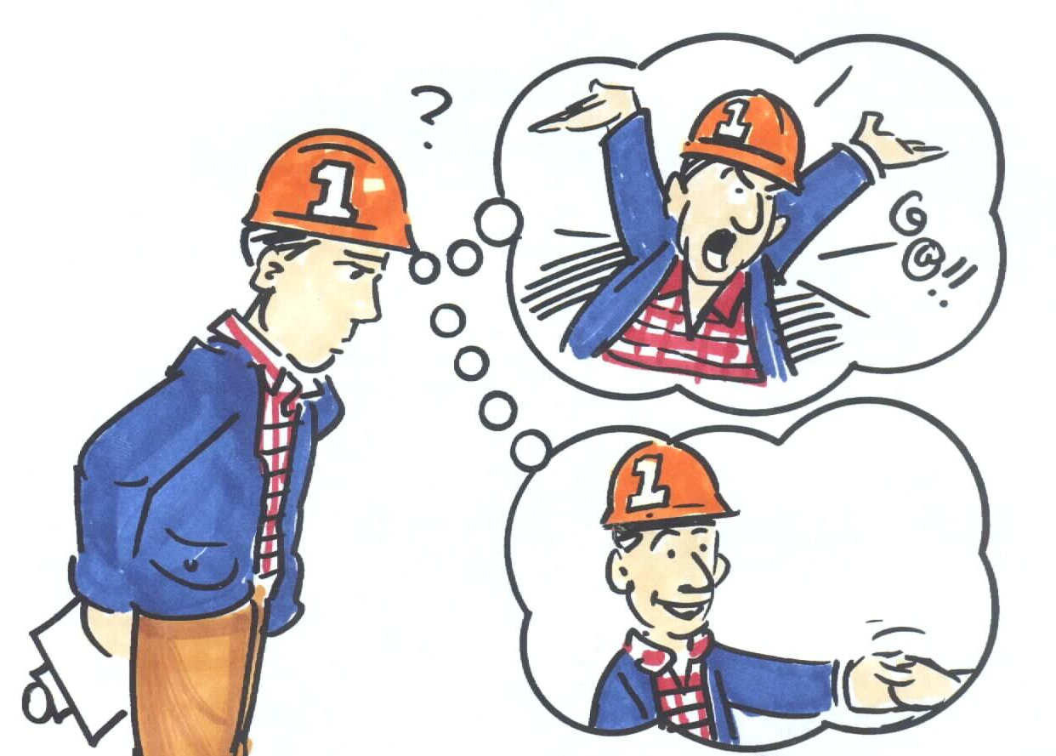
Remember, It’s all About the Conversation
(1990) E. Scott Geller
We will have more safety conversations and less fault-finding communications!
Notes:
Again….emphasize it’s all about the conversation!

Slide 63
What is Your Level of Listening?
Non- listener
Marginal
Listener
Evaluative
Listener
Active
Listener
Empathic
Listener
Notes:
Once skill that take a great deal of skill is listening. Listening and getting into a conversation are keys to helping make the STEP process a success.
Non-Listener: You are blatantly not listening…this may be a skill we need when we have multiple conversations going on around us. To be a good listener, in some instances, we may need to be a non-listener.
Marginal Listener: this level is where are maybe multitasking and trying to listen at the same time. In today's work world, with many conference calls, one might be tempted to multitask while on a conference call (show of hands….how many of you ?)
Evaluative Listener: Have you ever caught yourself wanting to finish someone’s sentence…or thinking about your rely even before the person has finished their sentence?
Active Listener: is a skill where you probably could repeat back exactly what was said and you seek clarification through paraphrasing and questions before you make a comment. This is the level we want to strive for.
Empathic Listener: Is the step above Active listening where you not only listen well and be an active part of the conversation, but you also look for cues from body language, word choice, word order and general affect of the person your speaking with. This is the level many clinicians and counselors hold conversations (Have you ever hear someone say…How does that make you feel??)

Slide 64
Improve Your Listening Skills
Pay Attention – focus on content, not delivery
Respond – seek clarification, question, paraphrase
Let speaker finish – don’t prepare what to say next
Main Ideas – facts, feelings, values, opinions
Eye Contact – focus on the speaker, not your watch
Notes:
Review and give personal examples…they work the best for this communication skills!

Slide 65
Feedback Exercise:
In the statements below, use the communication techniques just described to create a good safety conversation.
As you walk by an employee from another craft, you notice that he might be stocking his supplies too high. This is a busy area and you’re concerned things might fall.
While talking to a Project Manager, you notice a craft reaching behind a machine. From your viewpoint, it looks like his hand could be in a pinch-point.
One of the strongest guys you work with is picking up a load that is typically done with a hoist. He’s one of your best guys, a trainer, and has several new people in his crew.
You see some craft talking while a mechanic is repairing their equipment. It is well over 90 degrees and you notice that the mechanic is not wearing the required eye protection.
You witness one of your employees giving feedback to a coworker about a risky behavior. It seems the feedback was taken well and they are both working hard to get their job done.
Notes:
If there is time…have people break into groups (if short on time…have people do the exercise as individuals). Then have the team take time to come up with specific examples for each instance. Make sure you refer the class to the previous strategies on previous pages. Once you have given them some time…make sure to keep them on-track…

Slide 66
Pre-Observation Thoughts
Who…will your focus be on?
What…do you expect to see?
When…would be the best opportunity to observe?
Where…would my observation and communication make the biggest impact?
Notes:
Before you go out to do a safety observations, think about what you may observe, what have you seen in the past and what should be your focus for this observation. Sometimes it’s easy to focus on things we find interesting and this can take our minds off of what we need to be focusing on….be intentional in your observations!

Slide 67
Agenda:
STEP Purpose
Engagement
STEP Process
Participation
Data Use
Quality
Notes:
REVIEW SLIDE:

Slide 68
Error-Likely Situations
Complexity:
Too many steps
Too many people (communication issues)
Workload:
Too heavy or too light (performance is best when workload is moderate)
Too much reliance on human vigilance/monitoring
Design:
Focus on functionality, while ignoring the real-life user
The work environment in which a system functions also impacts the failure rate
Interruptions / Distractions:
Frequently associated with errors – up to 50% in aviation studies
Yet extremely common in healthcare – ER physicians experience up to 10 interruptions per hour
Culture:
Authority structure influencing communication
No assignment of responsibility

Slide 69
STEP PARTICIPATION
Improve Safety Culture through STEP observations and safety conversations
Safety Teams conduct observations
Monitor observation quality
STEP data communication IAW Data Use Plan
Improve contractor engagement / awareness
Improve Leadership engagement conversations
Conduct Focused Observations based on the data
Reduce probability of serious injuries & fatalities
Notes:
Based on feedback from our employees, leaders, contractor partners, and the survey data, we focused on several changes.
REVIEW SLIDE:
Each item will be discussed in more detail in the slides to come.

Slide 70
STEP Process: Participation Expectations
Everyone will participate per management guidelines.
Participation can be individual, in pairs or in a group.
Based on the weekly look back/ahead, select a location, contractor, task, or floor as your target.
Complete the observation or inspection on paper or in the SafetyNet app immediately following the participation.
Will the person observed get punished?
While employee discipline is the responsibility of the employer, STEP is designed to be No Name, No Blame, No Shame. Employee discipline as a result of a STEP observation is detrimental to the process.
Notes:
REVIEW SLIDE
Here are the expectations

Slide 71
STEP CHAMPIONS
A STEP Champion will be assigned to work group as established by management
The STEP Champion can be rotated but should primarily be project leadership.
The STEP Champion will coordinate the “Safety Team”.
The Safety Team will be comprised of volunteers from each workgroup (to be determined by STEP Champion).
The number of volunteers from each group will be based on management directives.
The STEP Champion will take the lead on creating the SafetyNet Data Use plan IAW management directives.
Notes:
We are emphasizing 5 main areas in STEP
1) Every Project will have a STEP Champion. Some Projects may already have a STEP Champion. They may continue on as Champion or assign another. The STEP Champion will help coordinate the STEP Safety Team, run SafetyNet reports for their project, develop and assess the project’s Data Use Plan and help facilitate the STEP portion of the weekly meeting. Ideally, this position should rotate and not be only assigned to safety personnel.
2) The STEP safety team will be comprised of craft from the contractors on site. The larger contractors may have multiple representatives (at the discretion of the STEP Champion and Site Leadership).
3)Predictive-Based Observations will be the largest change for some projects. We will get into the details in a few slides, but essentially, we will use our data to help diagnose what type of observation we should do in the week to come. This may change every week based on the needs and/or data of the project.
4) A Data Use Plan will be developed by the STEP Champions from the projects. This plan will ensure the data collected from STEP 2.0 will be used and acted upon on a regular bases.
5) The site leadership and STEP Champion will also ensure that quality observation are being collected through methods described in later slides. These methods include using the Observer Index, and doing paired observations.

Slide 72
Participation: Project Staff Engagement
Each project will assign one/or more STEP Champion/s.
The STEP Champion can be rotated but should primarily be project leadership.
The STEP Champion will coordinate the “STEP Team”.
The STEP Team will be comprised of volunteers from each contractor (to be determined by STEP Champion).
The number of volunteers from each contractor will be based on the size/duration of work.
The STEP Champion will take the lead on creating the SafetyNet Data Use plan for the project staff as well as the contractors.
Notes:
REVIEW SLIDE

Slide 73
Participation: Site Leadership
Project Leaders will help develop the SafetyNet Data Use Plan.
Leaders will also use the STEP data in their weekly meeting, as outlined in their Data Use Plans.
The leadership will monitor and assess the quality of the STEP observers and the data obtained.
Based on the STEP data, the week look-ahead, historical information, upcoming tasks or other serious injury/fatality precursors, the project staff will recommend what types of STEP checklists should be used.
All Project leadership will be required to participate.

Slide 74
Participation: Craft Engagement
Contractors and their craft will fully participate in STEP.
Each project will create a craft-focused “STEP Team”.
Each contractor will volunteer craft to participate on the STEP Team. Membership can rotate.
The number of craft volunteers will be determined by the Project Leadership.
The project STEP Champion will coordinate with the contractor and lead the STEP Team.
The craft will rotate at regular intervals to keep a fresh set of eyes on the safety of their coworkers.
Notes:
REVIEW SLIDE

Slide 75
Participation: Contractor Leadership
Contractor leadership will actively use the data obtained through the STEP process.
Each contractor will collect, analyze and use their data based on the SafetyNet Data Use Plan as determined by site leadership.
The contractor site leadership team will also be required to participate by performing observations and/or inspections based on their analysis of their STEP data.
The leadership will incorporate their STEP data into their preexisting meetings and pre-job briefs.
The contractor leadership will also monitor the quality of their STEP observations and data, based on the analysis of their data.
Notes:
REVIEW SLIDE

Slide 76
Expectations: Weekly Staff / Safety Meetings
During Meetings:
The Week “Look-Back”
Review the incidents, near-misses, first-aides, and behaviors from the previous week
Review the previous weeks observational data
Review the open-items
The Week “Look-Ahead”
Identify potential safety “clashes”
Look for Serious Incident Precursors
Pin point any Error traps
Notes:
REVIEW SLIDE

Slide 77
Predictive-Based Safety
Once we have completed our Safety Diagnostics, we prescribe various types of observations.
Based on our data, we are attempting to predicting where a potential incident, injury, near-miss or error might occur.
Our tools to help our weekly focus are:
Serious Injury/Fatality Precursors
Error Traps
Project / Work Area considerations
Intuition
Notes:
REVIEW SLIDE

Slide 78
Predictive-Based Observations
Two Types of STEP Participation:
Inspections (Compliance-Based)
General Compliance (Broad focus on Rules/Regulations)
Focused Inspection (Narrowing based on data or need)
Observations (Behavior-Based)
Generic Behaviors (Broad focus on action of employees)
Focused Observations (Narrowing based on data or need)
Notes:
So there are two types of checklists we will start out with and as more as needed. This will be facilitated by the STEP Champions across the projects.

Slide 79
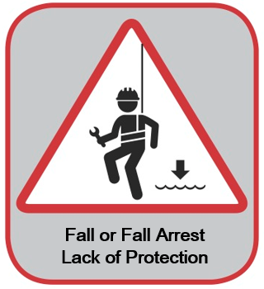
Generation Critical Risk Selections
Tasks identified
Scaffold build
Stack Inspection/repair
Open floor holes
Anchor point identification/inspection/ certification

Slide 80
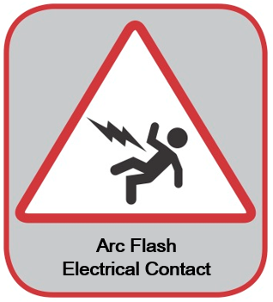
Generation Critical Risk Selections
Tasks identified
Switchyard entry
Mobile equipment in switchyards
Racking breakers
Clearance/LOTO
Installing temporary protective grounds
Back-fed panels
Digging

Slide 81
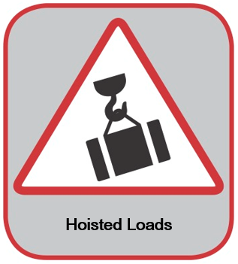
Generation Critical Risk Selections
Tasks identified
Rigging activities, such as boiler tubes, turbines, etc.
Engineered lifts

Slide 82
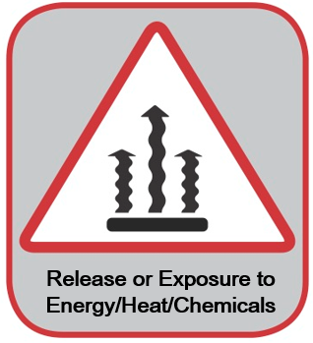
Generation Critical Risk Selections
Tasks identified
Removing boiler door
Inspecting online
Hazardous valve operation
Online condenser inspection
Tube leak repair
Ammonia systems start- up

Slide 83
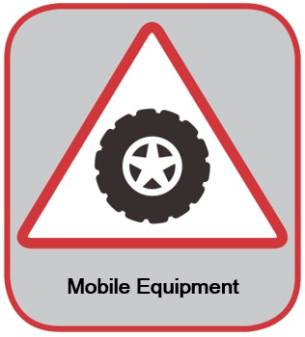
Generation Critical Risk Selections
Tasks identified
Forklift
Pedestrian pathways
ATV/UTV usage
Bulldozers
JLG/Scissor lift
Bucket truck
Mobile cranes
Overhead cranes

Slide 84
Agenda:
STEP Purpose
Engagement
STEP Process
Participation
Data Use
Quality
Notes:
REVIEW SLIDE:

Slide 85
Data Use Plan: Site Team
Every designated group will be required to complete and follow a SafetyNet Data Use Plan.
Process:
Work with group leadership to develop the SafetyNet Data Use Plan.
Discuss team responsibilities.
Roll out the new SafetyNet Data Use Plan.
Hold each other accountable for working the plan.
Notes:
REVIEW SLIDE
The STEP Champion will help develop this for each project

Slide 86
Data Use Plan: Contractors
Every contractor will be required to complete and follow a SafetyNet Data Use Plan.
Process:
Work with contractor leadership to develop their SafetyNet Data Use Plan.
Discuss contractor responsibilities.
Role out their new SafetyNet Data Use Plan.
Hold each contractor accountable for working their plan.
Notes:
REVIEW SLIDE
The STEP Champion will help develop this for each contractor (based on need)

Slide 87
SafetyNet Data Use Plan
Type of Report | Frequency | Target Contacts | How Communicated? | Anticipated Report Value | Information Captured
Contractor Summary Report | Monthly |  | Program Coordination Meeting | to review contractor’s performance, recognize positive achievements, develop action plans for identified areas requiring improvement, ensure observations are commensurate with risk | Shows inspection information for each contractor affiliated with the project, including the number of inspections completed, safe and unsafe observations, percent safe and dates and times of last inspection
Detailed Report | Monthly |  | Communicated Internally Amongst Safety Leaders | Feedback to inspectors, improving trending, focus resources | Detailed inspection observation information, line by line, with comments.
Observer Summary Report | Weekly (Sun) |  | Semi-Monthly Daily Safety Field Meeting (Monday Morning) | Driving accountability (Who?), ensuring inspectors are meeting expectations, recognize positive achievements and develop action plans for identified areas requiring improvement. | Shows, by each individual user, the total number of inspections and observations within a given time period, as well as last synchronization and inspection date.
Open Issues Report | Daily |  | Program Coordination Meeting, Communicated Amongst Safety Leaders | Ensure open issues are being closed in a timely manner risk categorization. High risk closed faster than lower risk. | Shows a list of all uncorrected observations for the project. Can be used to track and follow up on items that are close to, or over their due date. (Don’t wait to communicate open issues at this meeting, they should be communicated immediately.)
Summary Report | Weekly (Sun) |  | Daily Safety Field Meeting (Monday Morning) | Provides opportunity to coordinate inspection activities based on cumulative weekly observations. Focus can be shifted as necessary. | Summarizes observation information for all leading indicators, sorted by safety category and/or sub-category.
Summary Report | Monthly |  | Semi-Monthly Manager Meeting | Facilitates the development of short term action plans and long term initiatives based on collected data.

Slide 88
Agenda:
STEP Purpose
Engagement
STEP Process
Participation
Data Use
Quality
Notes:
REVIEW SLIDE:

Slide 89
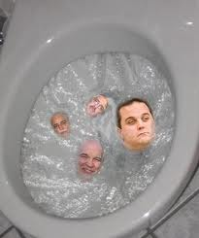
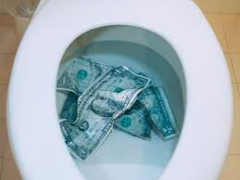
The “Venomous Cycle”
Notes:
When the observation intelligence gained from the process is not used, misused, or just plain ignored, the “venomous cycle” begins and a far too typical scenario follows. Employees soon lose faith in the process when the data fails to be acted upon. As a result, the next observations completed may not be done with the same quality and the data suffers. If this continues, people begin to see no value in doing the paperwork and often will “pencil-whip” the observation by checking off boxes. The team and leaders begin not trusting the data and may disregard the information. This lack of trust decreases the likelihood that the data will be acted upon.

Slide 90
Venomous Cycle
…How do Processes Lose Momentum?
Organizations sit on their information…Big problem!
Some leaders hand it off to Safety…BIG problem!
There is often no follow-up…BIG problem!
Employees see no value…BIG problem!
People lose faith…HUGE Problem!
Just another “flavor of the month”
Notes:
REVIEW SLIDE

Slide 91
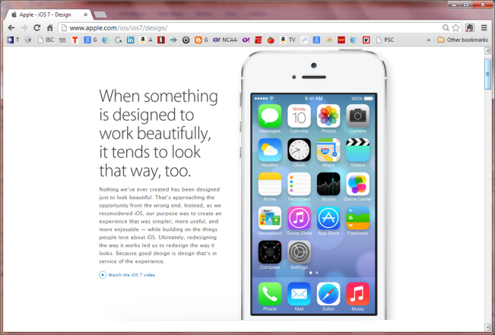
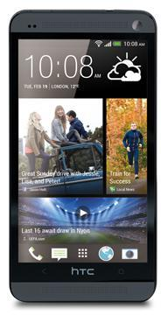

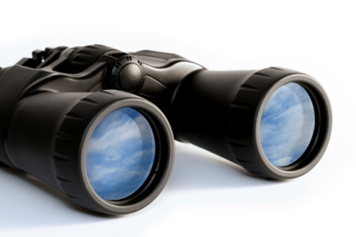

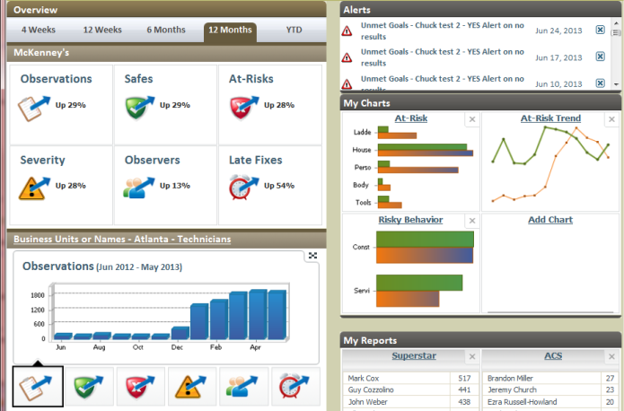
The
“Virtuous Circle”
ANALYZE
PREDICT
COLLECT
Notes:
Escaping the venomous cycle requires thinking differently about your process data and (re)engaging your leadership team. This requires teams to assess how well they are using their observation intelligence. Strategically using the observation data can help drive the critical importance of the process to the whole organization.

Slide 92
Observation Quality: Defined
Conversation: Conversation between observer and person being observed.
Comments: The comments section of the STEP observation filled out. Safe or at-risk observation. Describe what was observed. Tell about the conversation.
Paired-observation: The intent is that two observation per month be performed with a peer. A fresh set of eyes on work area.
Pictures encouraged: May require another committee to discuss electronic devices to perform STEP observations.
Notes:
Enter detailed information from your conversation in the comments section of SafetyNet to paint a picture for those who did not witness your observation. Pictures may added to the observation to provide an even better understanding.
Do not include the name or any characteristics which would make it easy to identify the person being observed. Talking with the observed individual/group and their leadership to correct an at-risk behavior or to commend a safe behavior is acceptable. Remember: NO NAME, NO BLAME, NO SHAME.

Slide 93

We Need to STOP
Reacting to Injuries…
And START
Predicting Them!

Slide 94
We Still Have Work to Do…
People Power Safety

